Slide 1
Pre-Calc & Trig
Day 58

Slide 2
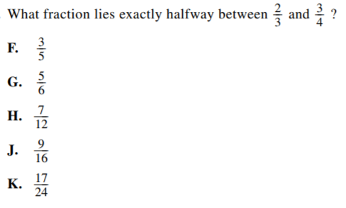
Bell Work:

Slide 3
Bell Work Answer
Use your calculator to add the two fractions and divide the answer by 2.
The answer is: K

Slide 4
Bridge Project Day 3
Your group should be finalizing bridge builds, and begin to write/type up formal reports.
Ideally we are testing bridges next class, but if we have to push it back a day we can. It will all depend on if you use class time wisely today! So work hard!

Slide 5
Objective
To build a bridge that covers the required gap, holds the most weight, and follows your groups blueprints and measurements.
Document your groups process for a summative paper/write up.

Slide 6
Bridge Project
You’ll be in groups of 3 – 4
This project will involve some research, drafting, constructing, and testing
Pick your groups wisely

Slide 7
Overview
You will need blueprints for the side view of your bridge
Include both length measurements, and angle measurements.
Additional consideration given if you map out a blue print for the top/bottom and front/back

Slide 8
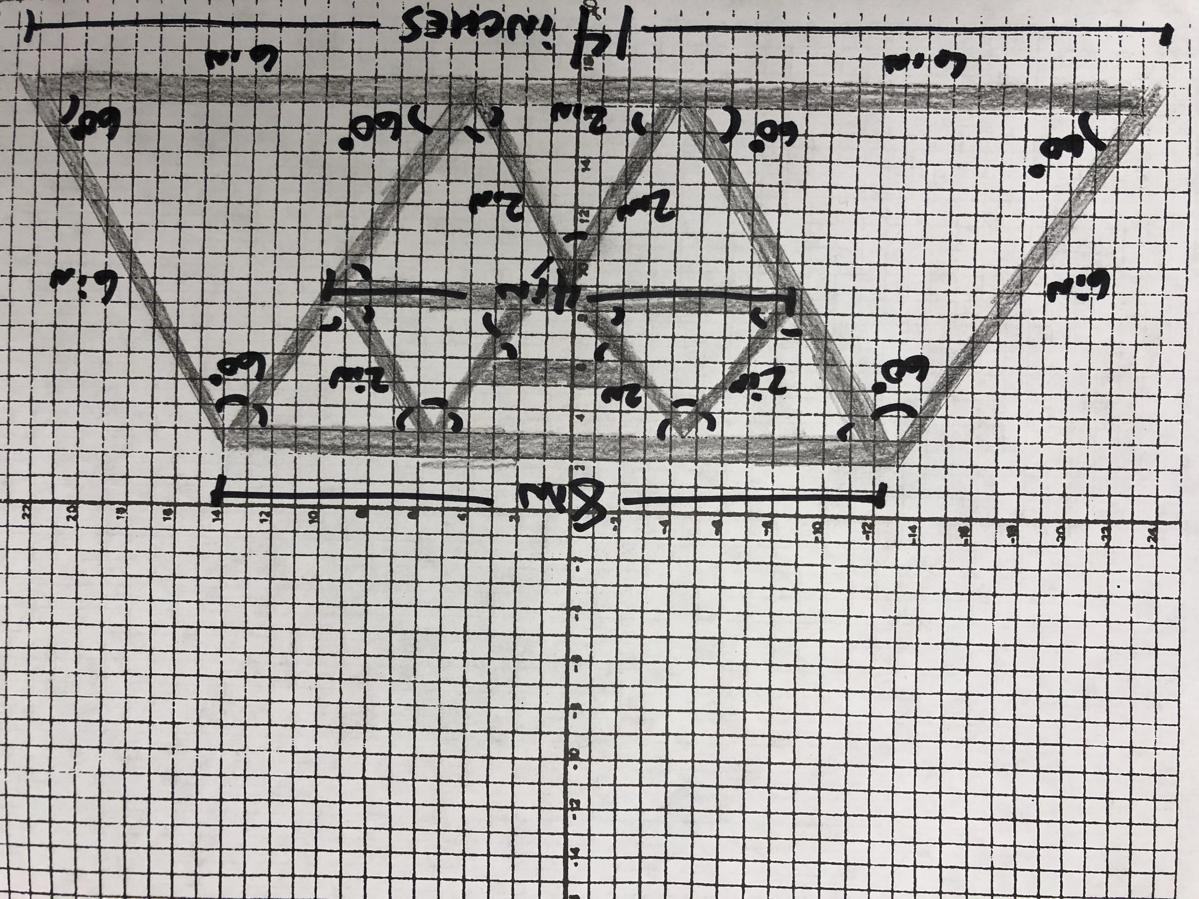
Example of Blueprint Measurements

Slide 9
Bridge Requirements
The bridge must span a gap of 14 inches (it can be longer if desired)
The bridge must allow a ‘car’ with a width of 3 – 4 inches to drive over it
The bridge must have a hole with a diameter of 0.5 inches in the center to attach the bucket
Only use the allowed materials (outlined on next slide)

Slide 10
Materials Allowed
Less than or equal to 200 popsicle sticks
Less than or equal to 2 rubber bands
Less than or equal to 4 index cards
Elmer’s Glue (provided)
Graph Paper for blue prints is encouraged

Slide 11
Schedule
Day 1:
Research & Design Bridges. Assign Roles. Get Angle & Side Measurements. Begin Build
Day 2:
Continue Building & Finding Angle and Side Measurements if needed.
Day 3:
Final Build Day. Finalize builds and mathematics
Day 4:
Test Bridges.
Finish write-ups

Slide 12
Grades
Formative:
Turn in blueprints. Clearly defined roles. Build completed on time. Appropriate use of class time.
Summative:
Build was true to scale. Weight supported. Formal Write – Up

Slide 13
Formal Write – Up
Daily Accomplishments/plans stated.
Clearly defined roles within the group
Summarize patterns within the length and angles used in building the bridge.
Defend why you built the bridge the way that you did (cite any sources used to help with research)
Attach blueprints

